Slide 1
LSPU CCS VO-AG ROOM SCHEDULING SYSTEM
BSCS – 2A
ALBERT Q. PASCO
DARIEL POLESTICO
MIKE NEO RENGHIE C. RATAC

Slide 2
OUR PROGRAM IS ALL ABOUT?
The Room Scheduling System in VOAG Building as a management reporting tool to help get the work done on time. Used to assist the user to locate the specific task.

Slide 3
OUR OBJECTIVES
Is to make more convenient to use, for what user’s needs.

Slide 4
Benefits/Beneficiaries
To reduce the complexity of schedule and for quick view of the user enable to assist them.

Slide 5
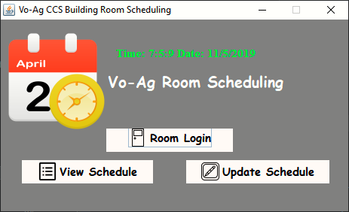
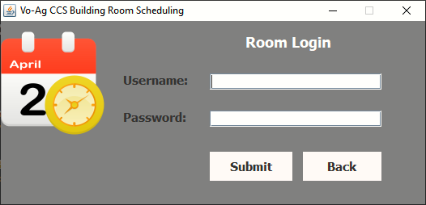
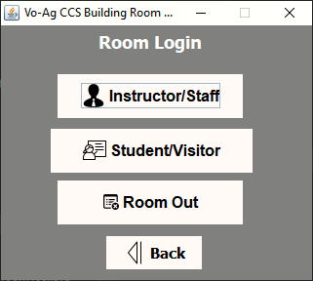
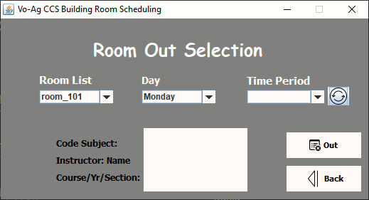
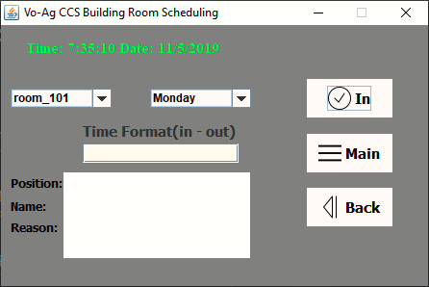
ROOM SCHEDULE SYSTEM

Slide 6
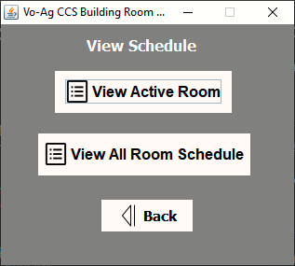
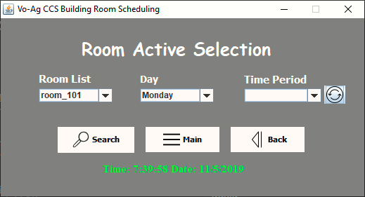
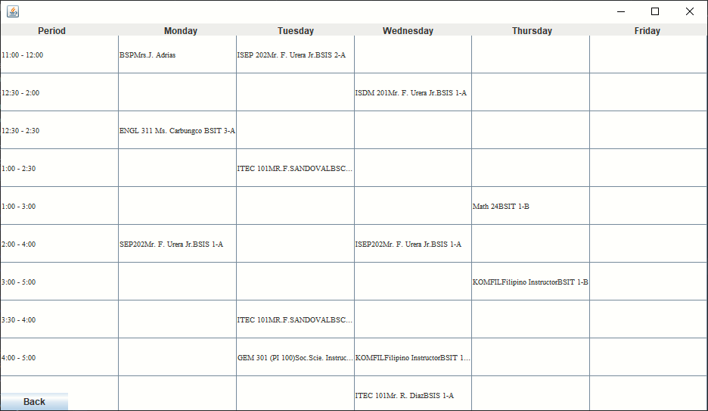
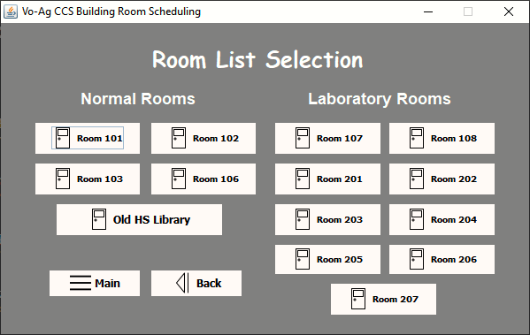
ROOM SCHEDULE SYSTEM

Slide 7
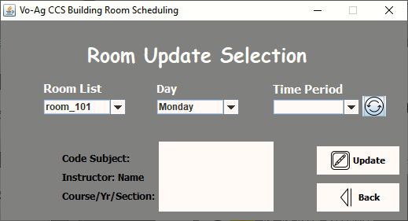
ROOM SCHEDULE SYSTEM

